Slide 1
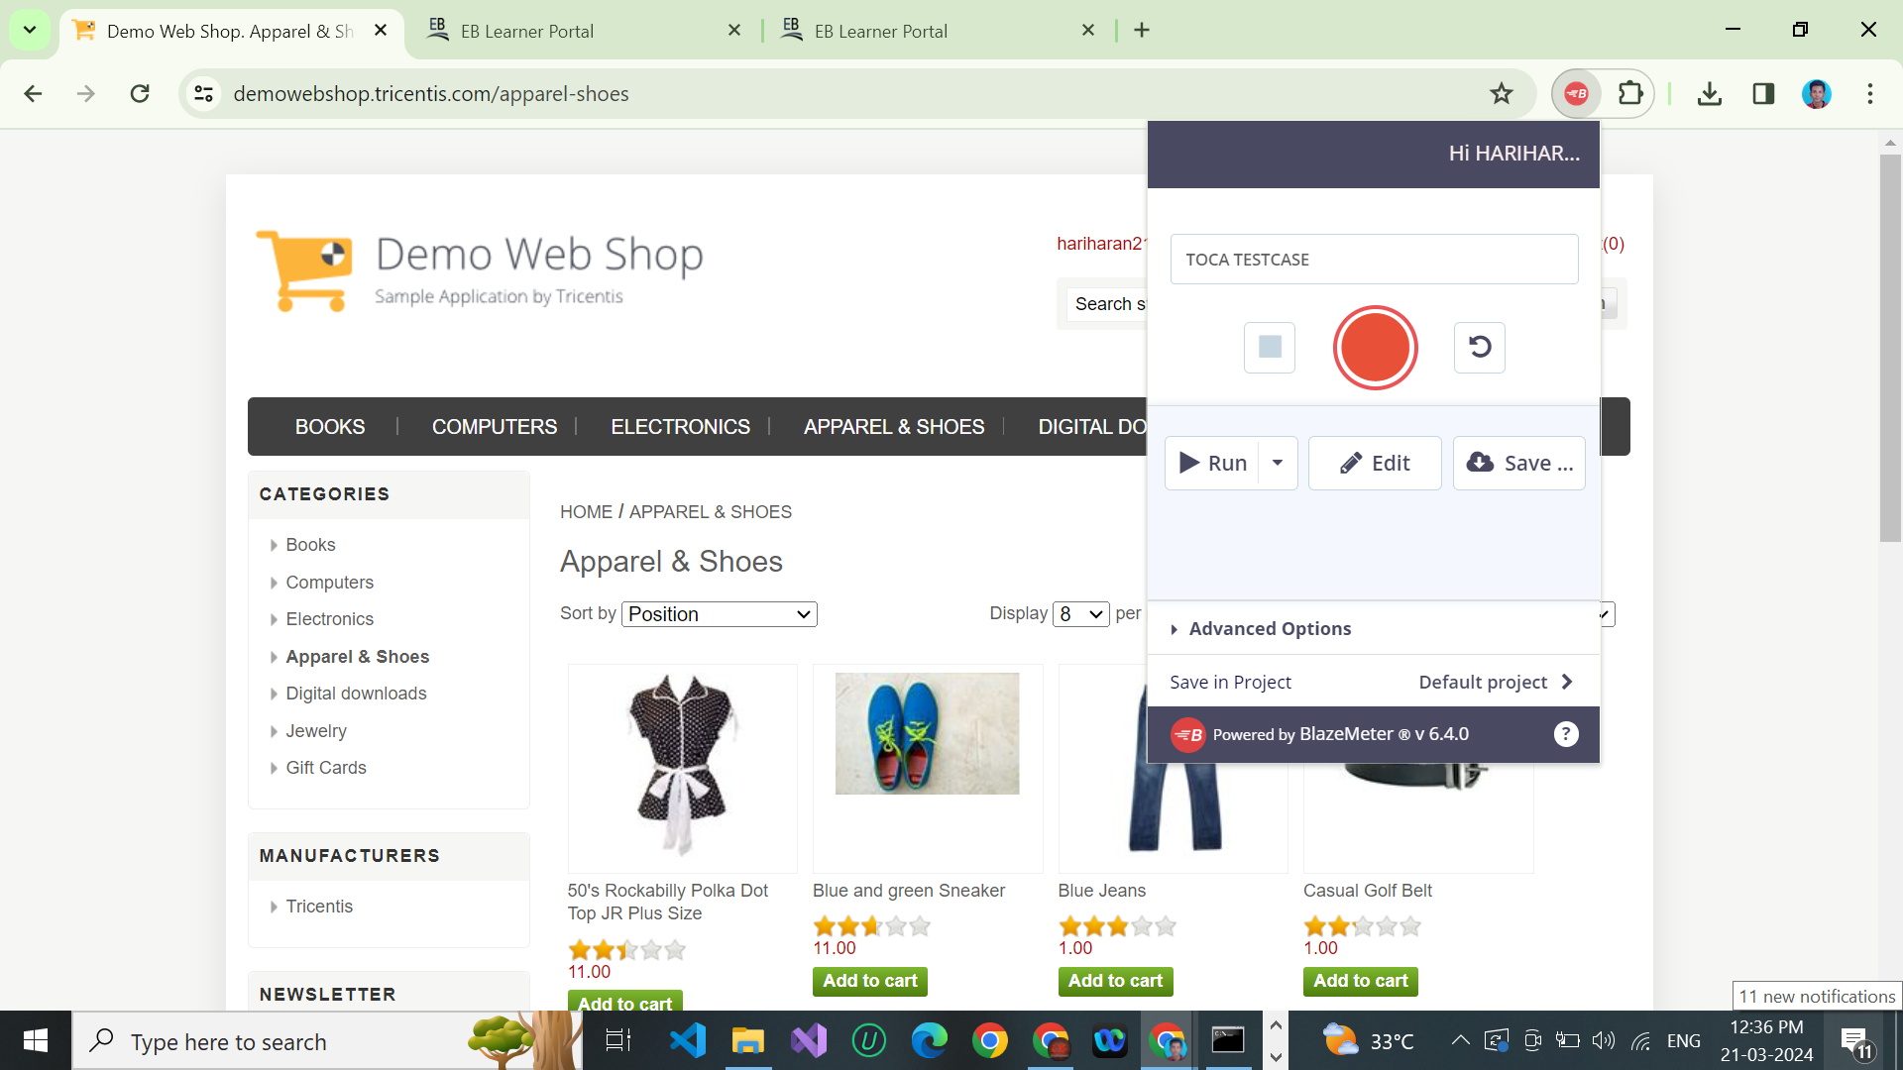
ASSIGNMENT - 10
STEP 1 : Use demo web shop url .
STEP 2 : We Use Blazemeter To Select The Different Url And Uri.
STEP 3 : After export the .Jmx file

Slide 2
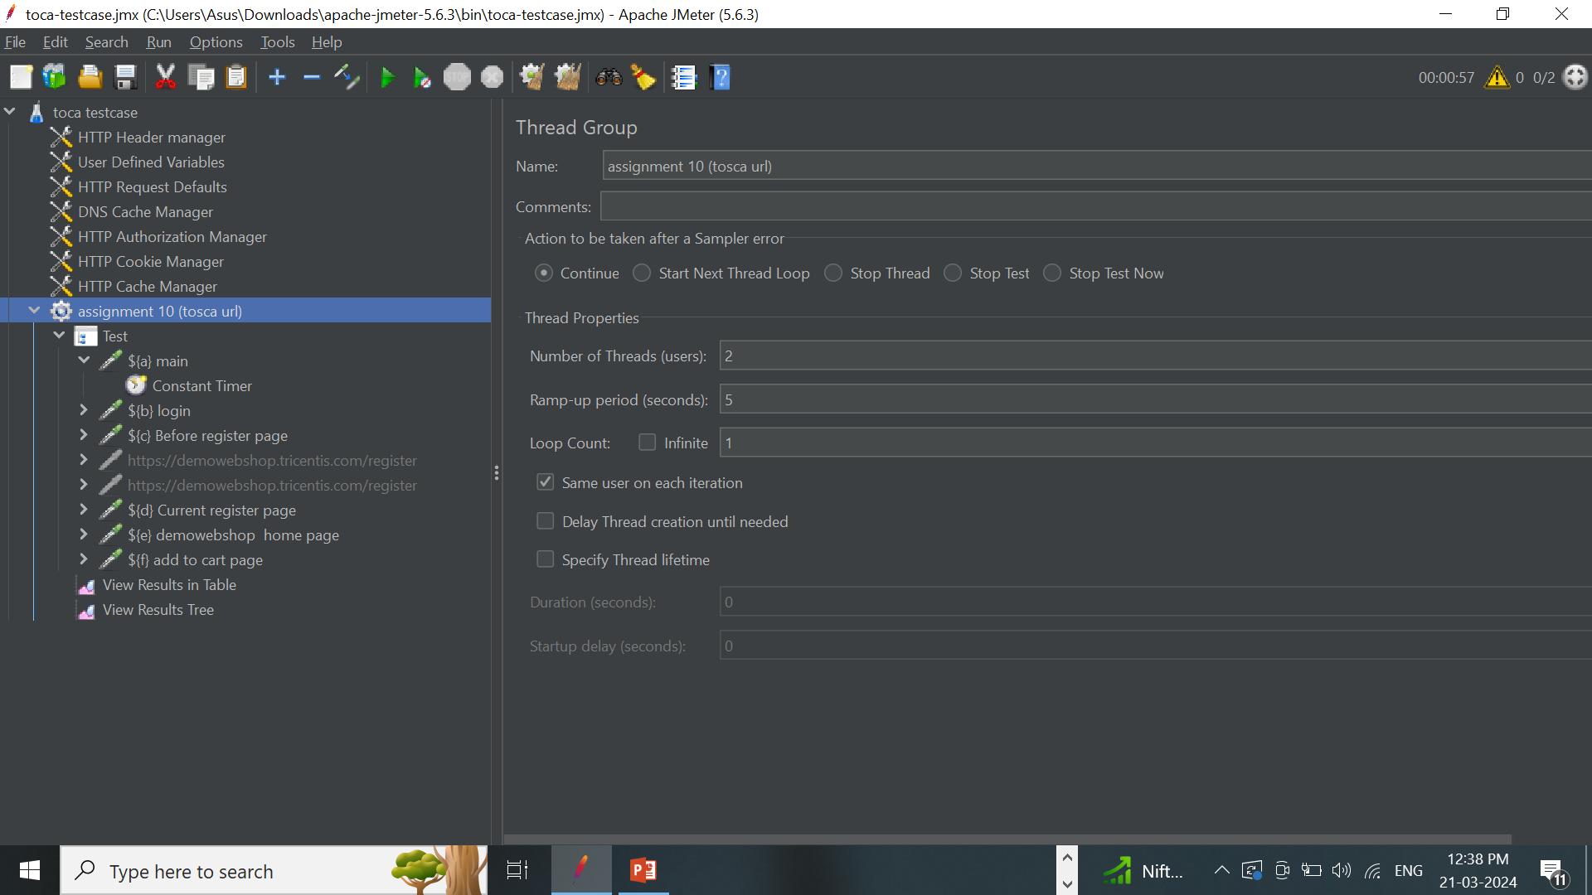
STEP 4 : IMPORT THE .JXM FILE INTO THE JMETER
STEP 5 : TO CHANGE THE SOME THREADS VALUES AND RAMP-UP PERIOD IN THREAD GROUP

Slide 3
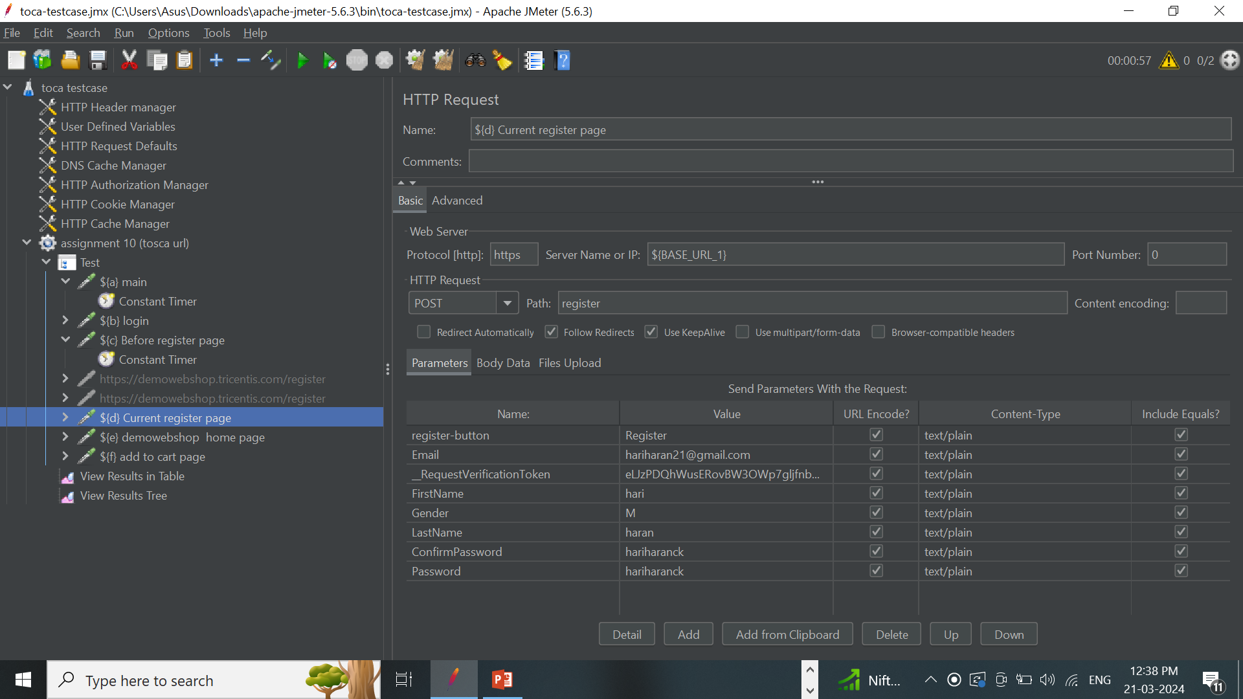
STEP 6 : CHECK THE SEE THE HTTP REQUEST (POST).

Slide 4
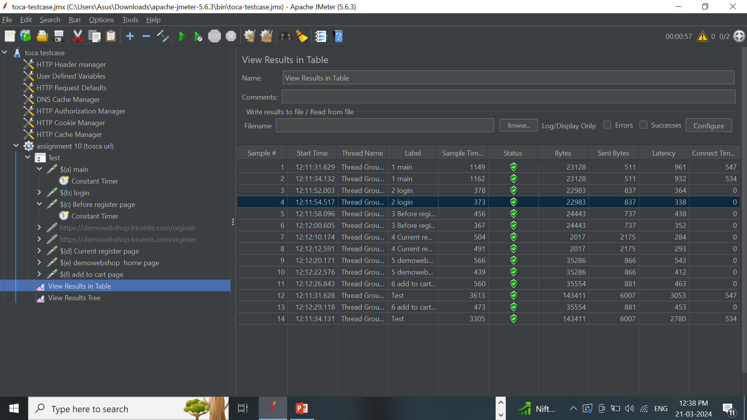
STEP 7 : CHECK THE VIEW RESULT IN TABLE

Slide 5
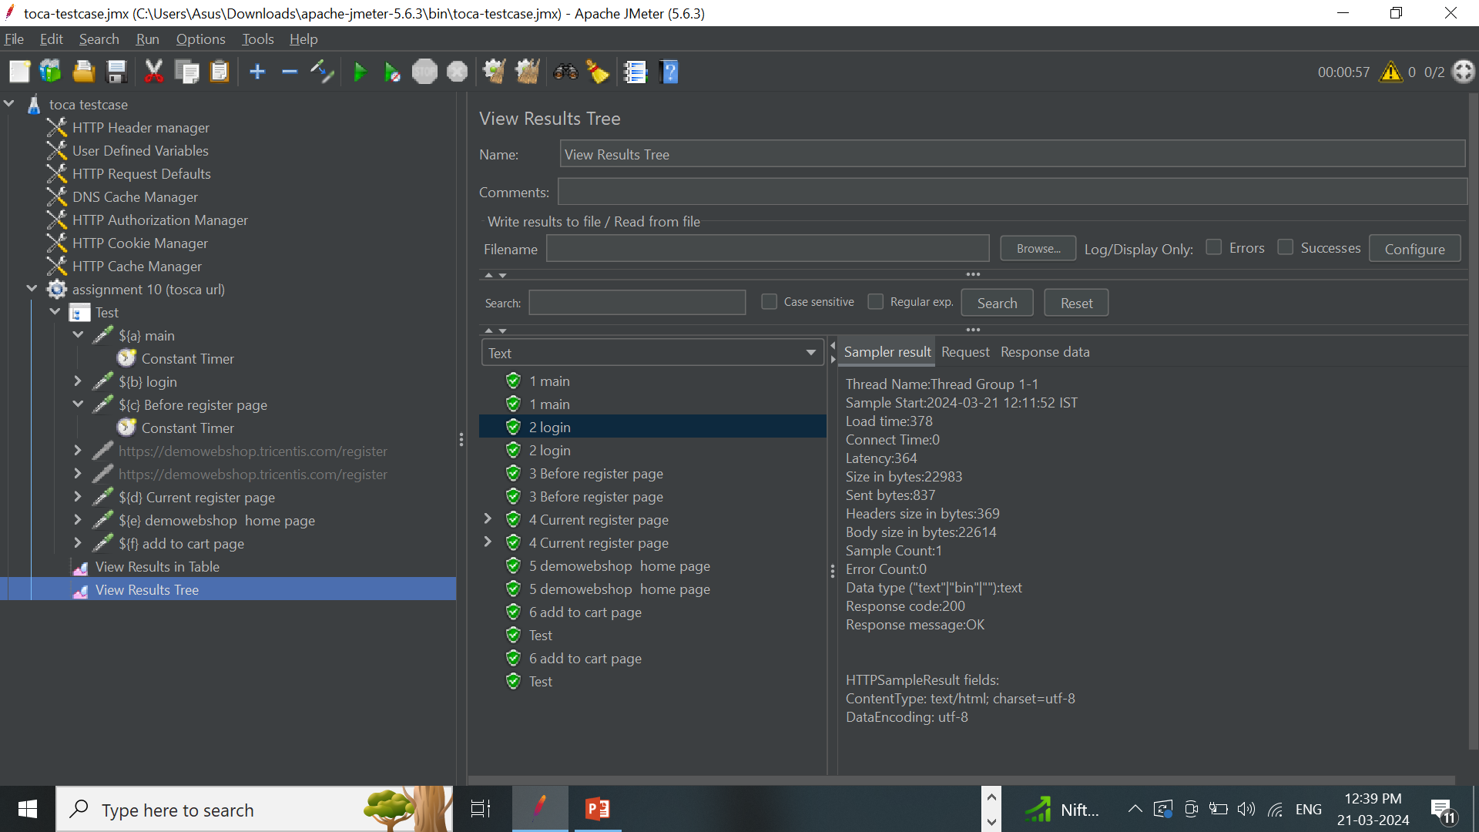
STEP 8 : CHECK THE VIEW RESULTS TREE.

Slide 6
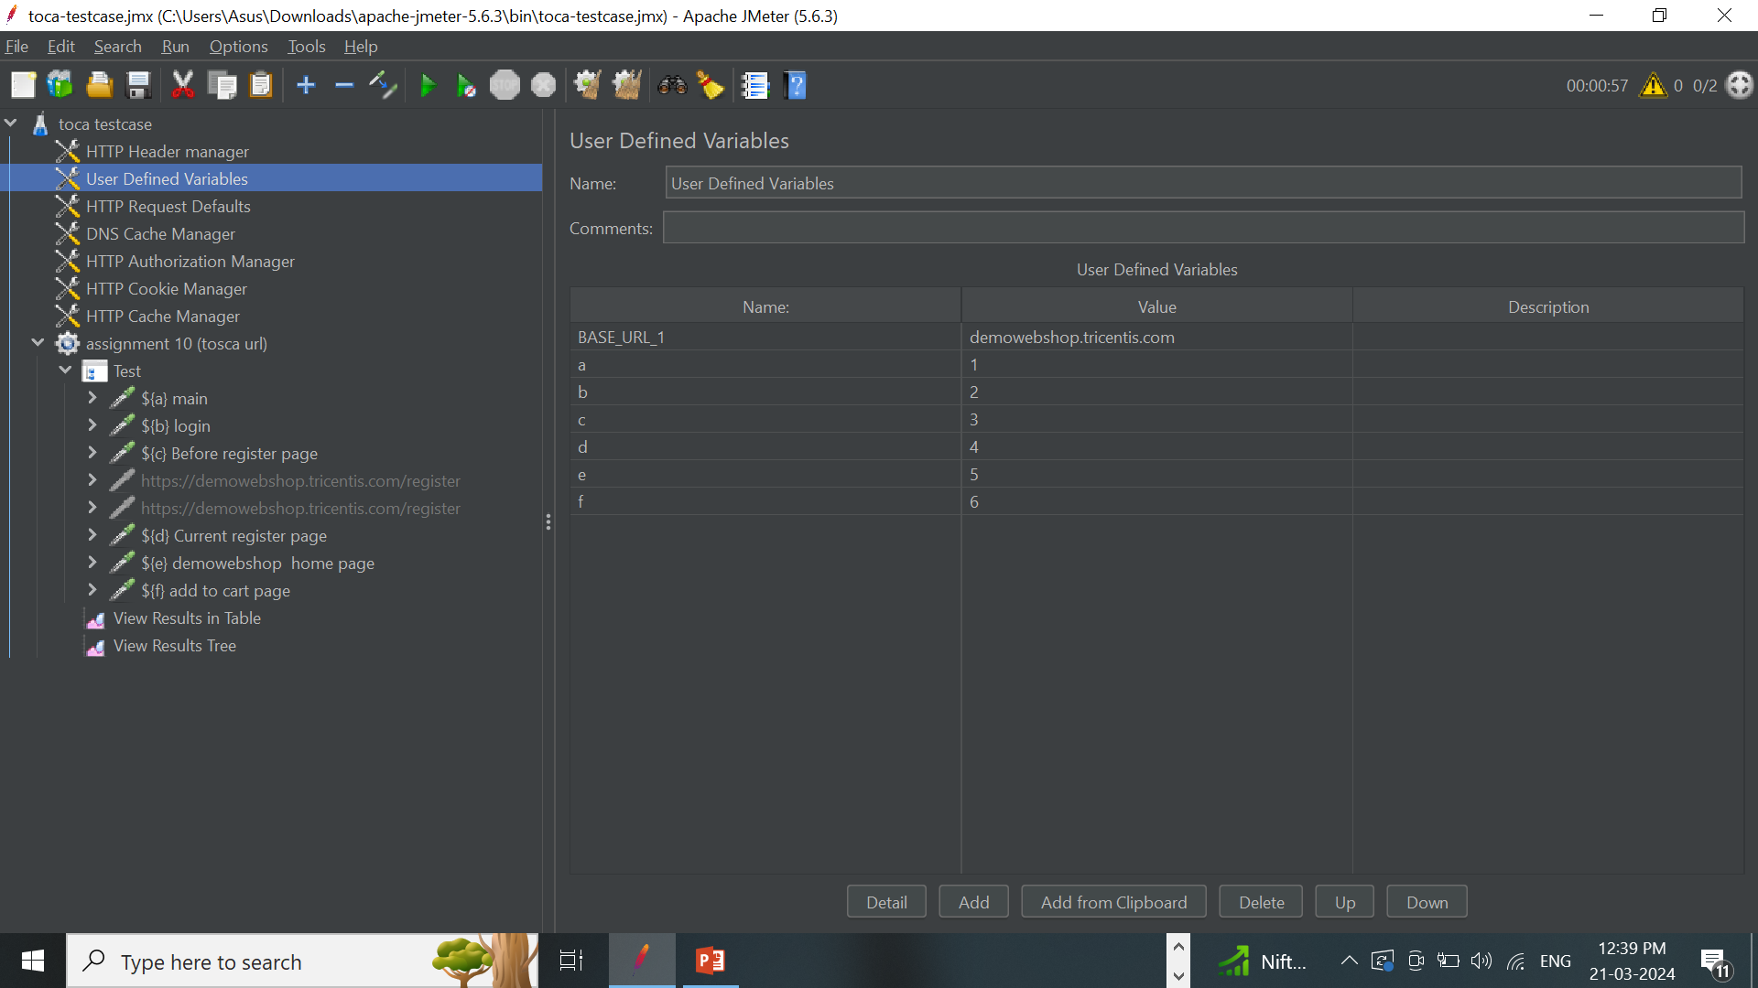
STEP 9 : CHECK THE USER DEFINED VARIABLES TO CHANGE OR SET THE NEW VARIABLE AND VALUE.

